Slide 1

Major Project Review-II
Batch No: 14
Project Title: SMARTER NER
S.No | Regd.No
1 | 22A81A0609 | CH.YASASWI
2 | 22A81A0644 | P.GEETHA RANI SRI
3 | 22A81A0616 | G.SRI NAGA SIRISHA
4 | 23A85A0605 | R.J.S.RAJU
5 | 22A81A0610 | C.NANDIRAJU
Project Guide:
DR.V.VENKATESHWARA RAO Professor, Ph.D

Slide 2
SMARTER NER

Slide 3
OUTLINE
Abstract
Introduction
Literature Survey
Problem Statement
Proposed System
Project Objective
Project domain
Requirement Analysis
Architecture
Methodology
Implementation and Result Analysis
Conclusion
Project Plan

Slide 4
ABSTRACT
This project presents a Named Entity Recognition (NER) system for Telugu, a low-resource language. It uses a hybrid approach combining manual annotation and semi-supervised learning to improve performance. A spaCy-based model is trained on labeled data and further enhanced using pseudo-labeling, dataset refinement, and retraining. Explainable AI using LIME is integrated to provide transparency in predictions, and a Streamlit-based web application enables users to input Telugu text and visualize entity recognition results. The system accurately identifies entities such as Person, Location, and Organization, providing an efficient, interpretable, and user-friendly solution.

Slide 5
INTRODUCTION
Named Entity Recognition (NER) is a Natural Language Processing task used to identify entities such as persons, locations, and organizations from text. Telugu is a low-resource language with limited labeled data, making NER a challenging task. To address this, our project uses a semi-supervised learning approach that combines labeled and unlabeled data. A spaCy-based model is trained and used to generate pseudo-labels, which are further refined by filtering low-quality data and retraining to improve accuracy. Explainable AI using LIME is integrated to make predictions transparent, and a Streamlit-based application provides a user-friendly interface for real-time analysis.

Slide 6
LITERATURE SURVEY
Sr no | Journal name and publisher year | Title | Technology | Identify entities
1 | Proceedings of WILDRE4, 2018 | "Named Entity Recognition for Telugu using LSTM-CRF" | LSTM-CRF | Person, Location, Organization
2 | Proceedings of ACL-SRW, 2022 | “"Leveraging Multi-Domain Named Entity Recognition with Pretrained Telugu Language Models" | BERT-Te, RoBERTa | Person, Location, Organization
3 | Proceedings of IJCNLP, 2022 | "Telugu Named Entity Recognition Using BERT" | BERT | Person, Location, Organization
4 | Proceedings of IJCAI, 2023 | "Fine-tuning Pre-trained Named Entity Recognition Models for Telugu" | BERT, RoBERTa | Person, Location, Organization
5 | Proceedings of ICML, 2025 | "Named Entity Recognition for Telugu and Kannada on Naamapadam Dataset Using Various Machine Learning and Deep Learning Algorithms" | BERT, CRF, SVM | Person, Location, Organization

Slide 7
PROBLEM STATEMENT IN EXISTING SYSTEMS
Most existing NER systems focus on high-resource languages like English, where large labeled datasets are available.
For low-resource languages like Telugu, there is a lack of annotated data, which limits the performance of standard NER models.
Existing systems lack explainability, making it difficult to understand model predictions.
Many systems rely solely on supervised learning, requiring extensive manual labeling that is time-consuming and expensive.

Slide 8
PROPOSED SYSTEM
.
Manual Annotation: A small, initial set of data is manually labeled.
Semi-supervised Learning: The trained model automatically generates "pseudo-labels" on a much larger, unlabeled dataset.
Model Training: A SpaCy-based NER model is trained on labeled data.
Dataset Refinement: Low-quality pseudo-labeled data is filtered to improve data quality.
Model Retraining: The model is retrained using the refined dataset to enhance performance.
Explainable AI (XAI):LIME is integrated to provide transparency in model predictions.

Slide 9
PROJECT OBJECTIVE
To develop a Named Entity Recognition (NER) system for the Telugu language
To improve NER performance in low-resource settings by using Semi-Supervised Learning.
To enhance model accuracy using pseudo-labeling, dataset refinement, and retraining.
To provide explainability using LIME for better understanding of predictions.
To build a user-friendly system using Streamlit for real-time text analysis.
To accurately identify entities such as Person, Location, and Organization.

Slide 10
PROJECT DOMAIN
• Natural Language Processing (NLP) • Machine Learning • Semi-supervised Learning • Explainable AI (XAI) • Web Application Development (Streamlit) • Data Visualization

Slide 11
REQUIREMENT ANALYSIS
Functional Requirements
The system should accept Telugu text as input and process it for entity recognition.
The system should identify and classify entities such as Person, Location, Organization, and Miscellaneous.
The system should support semi-supervised learning by using both labeled and unlabeled data.
The system should generate pseudo-labels to improve model performance.
The system should provide explainability using LIME to interpret model predictions.
The system should allow users to interact through a Streamlit-based web interface.

Slide 12
REQUIREMENT ANALYSIS
Non-Functional Requirements
Scalability: The system should be scalable to handle large amounts of text data.
Usability: The system should be user-friendly and easy to navigate.
Performance: The system should provide fast response time during inference.
Reliability: The system should provide accurate and consistent results.

Slide 13
REQUIREMENT ANALYSIS
Software Requirements
Python 3.8: This is the required programming language version for the project.
Operating System : Windows 7 onwards
Hardware Requirements
Processor: Intel Core i3 or equivalent
RAM: Minimum 4GB (8GB recommended for better performance)
Hard Disk: Minimum 256GB (SSD recommended for faster data access)

Slide 14
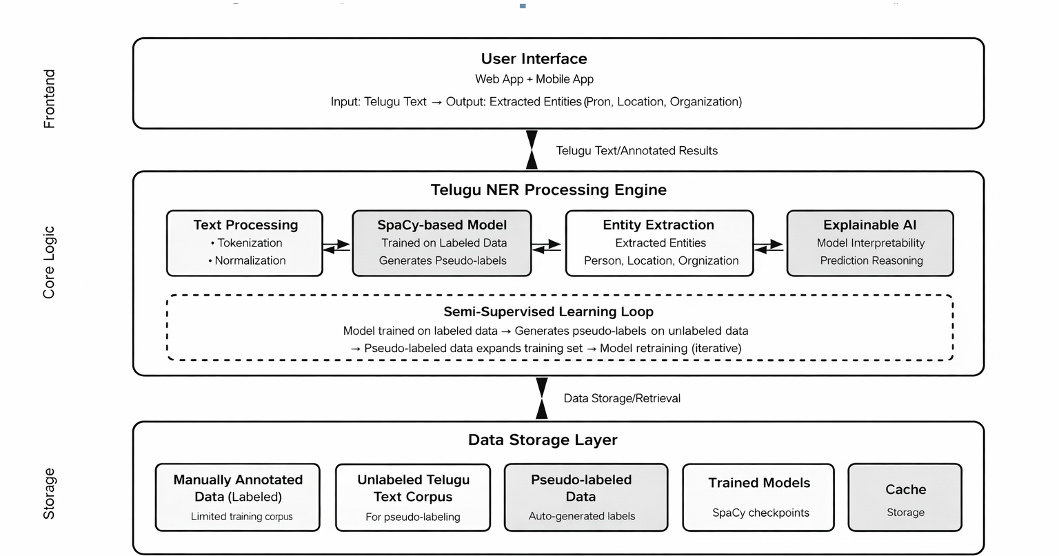
ARCHITECTURE

Slide 15
METHODOLOGY
Developing NER for Telugu: We build a Named Entity Recognition system for Telugu, a low-resource language.
Hybrid Approach: We combine manual annotation and semi-supervised learning to improve accuracy.
Manual Annotation: A small dataset is labeled with entities like Person, Location, Organization, and Miscellaneous.
Model Training: A spaCy-based model is trained on labeled data.

Slide 16
Pseudo-Labeling: The trained model generates labels for large unlabeled data.
Dataset Refinement: Low-quality pseudo-labeled data is filtered to improve data quality.
Model Retraining: The model is retrained using both labeled and refined pseudo-labeled data.
Explainable AI (LIME): LIME is used to explain model predictions.
Result: The system becomes accurate, efficient, and user-friendly for Telugu text analysi

Slide 17
Implementation
• Train the model using labeled Telugu data • Generate pseudo-labels from unlabeled data • Remove low-quality data • Retrain the model with improved data • Deploy the model using Streamlit • User enters Telugu text • System identifies entities (PER, LOC, ORG, MISC) •Explainability results using LIME and visualizations are displayed.
6.Explainability results with visualization are displayed.

Slide 18
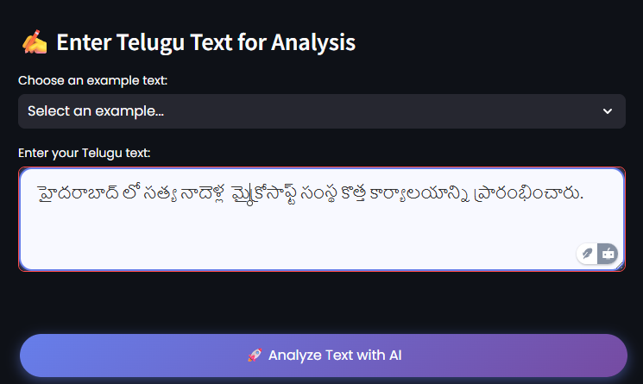
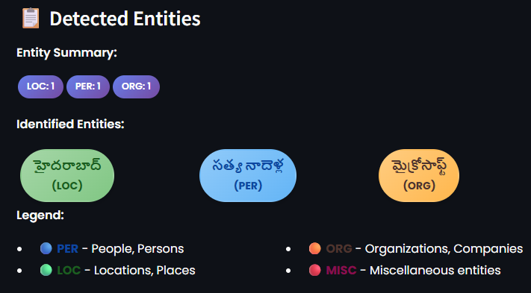
Result Analysis

Slide 19
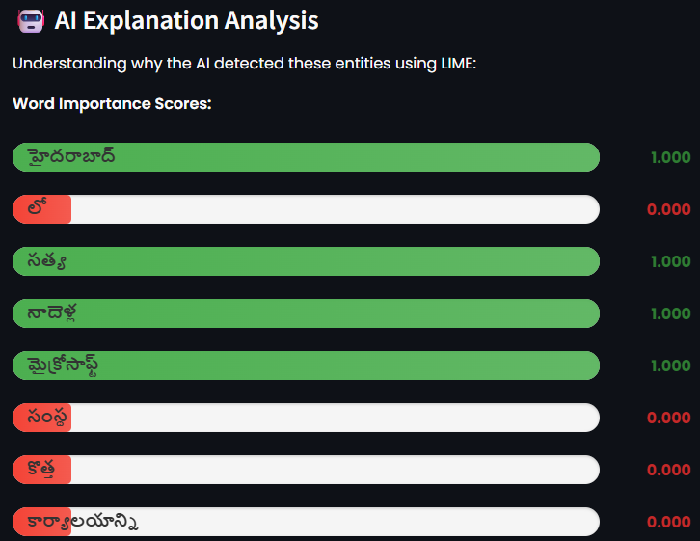
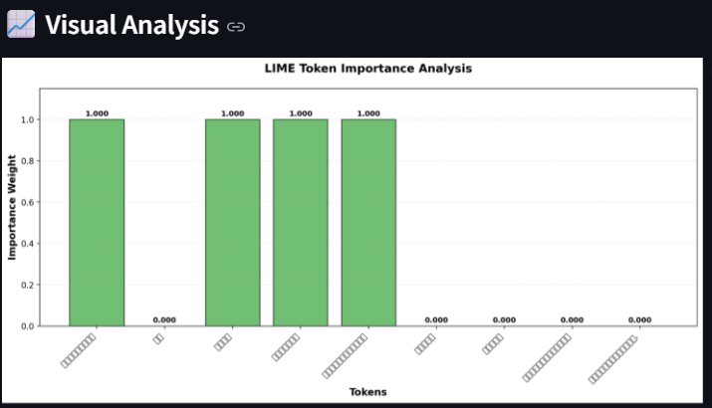

Slide 20
Conclusion
The project successfully develops a SpaCy-based NER system for low-resource Telugu text. By using semi-supervised learning, the model improves accuracy by learning from both labeled and unlabeled data. The integration of explainable learning makes predictions transparent and interpretable. The system can accurately identify entities like Person, Organization, Location, and Date, providing a reliable and user-friendly solution for Telugu text processing. This work contributes to advancing NLP for low-resource languages and demonstrates that effective, interpretable NER systems can be built without pretrained models.

Slide 21
Future Scope
• Add fine-grained entity types such as events, products, and numerical expressions
• Incorporate cross-lingual learning to improve performance using related languages
• Enhance explainability using advanced methods like SHAP
• Develop real-time applications such as chatbots, virtual assistants, and information extraction systems
• Extend the system to support multiple low-resource Indian languages
• Build more accurate, interpretable, and scalable NER systems

Slide 22
PROJECT PLAN
Project Timeline
Project Selection and Proposal Writing: 1 week
Requirement Analysis and Gathering: 2 weeks
Designing: 1 week
Web Interface Designing: 3 weeks
Backend Coding: 3 weeks
Deployment: 1 week

Slide 23
THANK YOU

